Slide 1
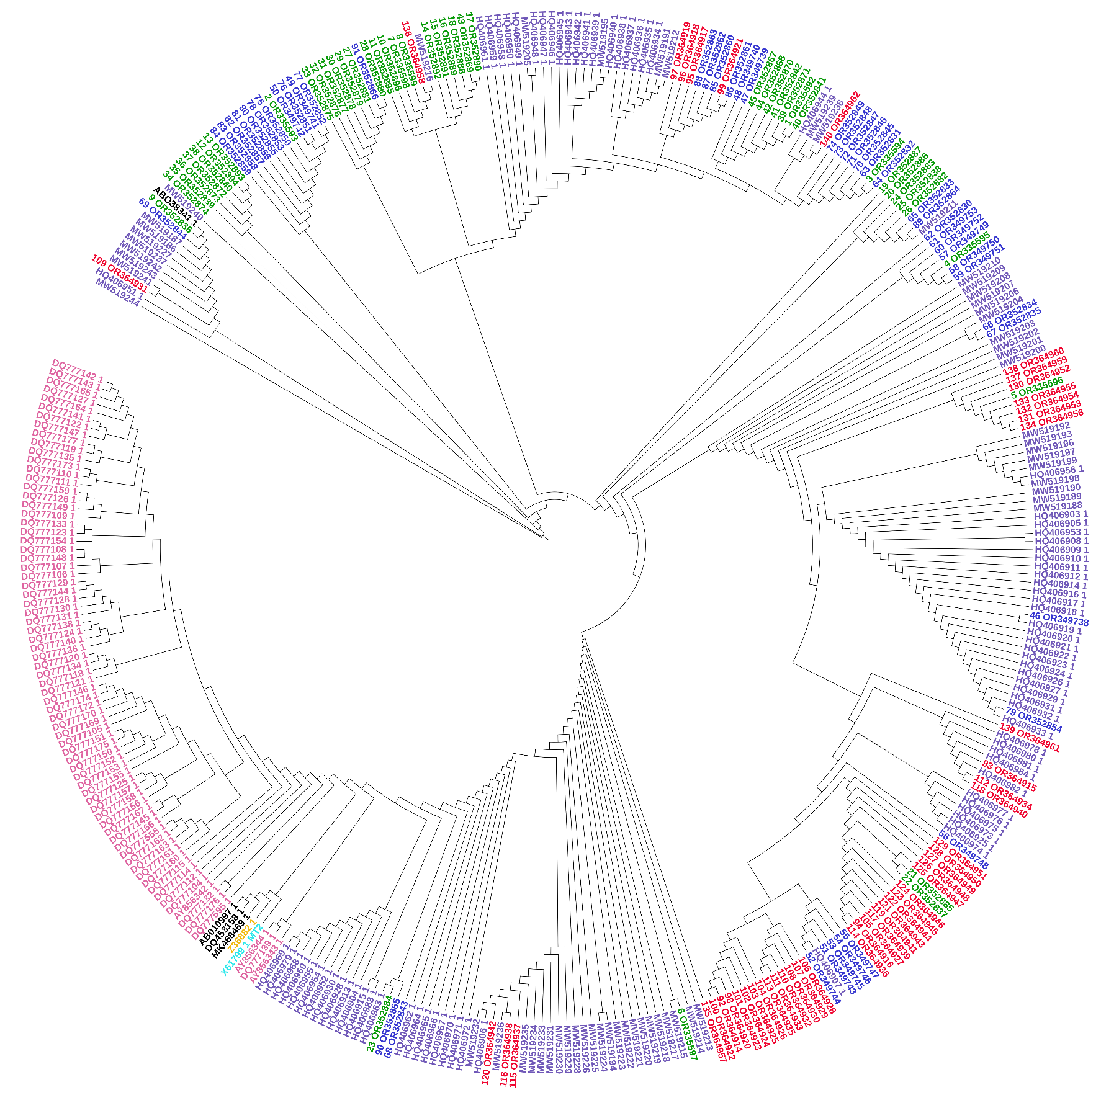
7-WGREC106.2.R3-AU-NPL 17
2-WGRECE.2-Random sampling
6-WGREC119.3.R2-Georgia-09B
5-WGREC5.1-AU-NPL 17
8-BARU2.1 -TUFRunnerTM ‘297’
A
3-GCREC45.1-AU-NPL 17
Alabama, BARU
Alabama, WGREC
Alabama, GCREC
B
Georgia
North Carolina
Asia
Europe
Hawaii-X61799.1_MT2
C
1-BARU25.1-AU-NPL 17
1-BARU25.1-AU-NPL 17
4-WGREC.B1-Random sampling

